Slide 1

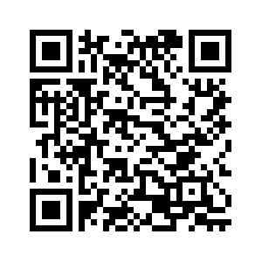
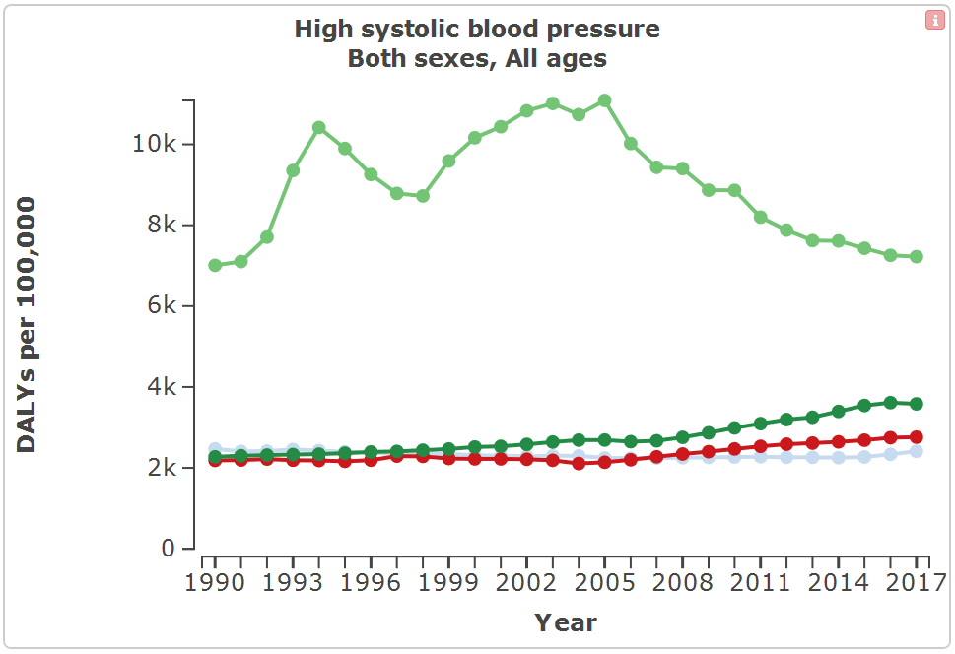
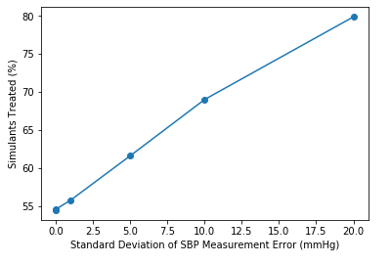
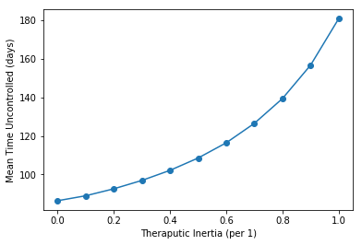
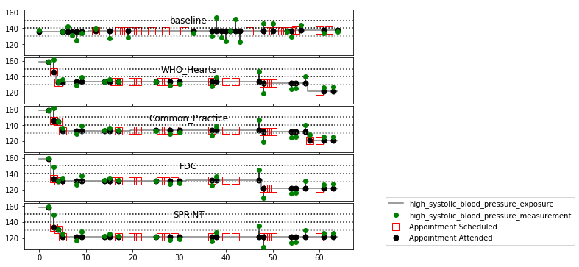
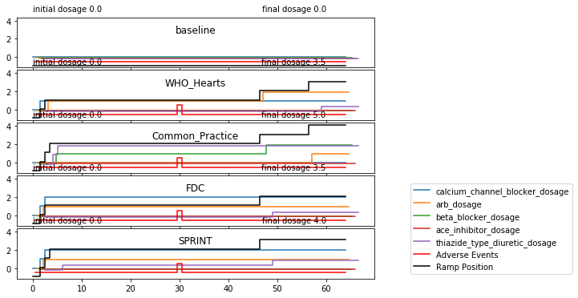
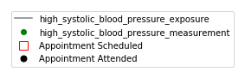
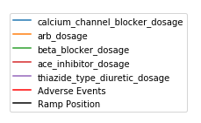
The impact of scaling-up screening and treatment for hypertension with fixed-dose combination therapy is large, and varies by country.
Non-Cognitive Predictors of Student Success: A Predictive Validity Comparison Between Domestic and International Students
Non-Cognitive Predictors of Student Success: A Predictive Validity Comparison Between Domestic and International Students
Health impact of hypertension control in four countries: an individual-based simulation model calibrated to Global Burden of Disease Study estimates
 | DALYs Averted (/100k PY) | SBP Shift (mmHG) | Change in % Controlled (pp) | Change in Time to Control (days)
Brazil | 991.0 | 7.4 | 17.8 | 55.2
India | 1524.2 | 6.2 | 14.2 | 44.7
China | 1604.7 | 6.3 | 14.3 | 40.8
Russia | 2963.8 | 8.2 | 18.4 | 58.0
Andrew Moran
Dorairaj Prabhakaran
Zixiao Li
Georges Saade
Paola Santalucia
Anthony Rodgers
Abraham D. Flaxman
Population Studied
1,000 replicates of cohorts of 1,000,000 adults representing the population aged ≥35 years in each of four middle-income countries.
Simulation Timeframe
2018 to 2023, with a 30 day step size
DALYs due to High SBP per 100k PY
INTRO
Globally, 218 million disability adjusted life years (DALYs) were lost due to systolic blood pressure (SBP) ≥140 mmHg in 2017.
The effectiveness of medications is established, but hypertension screening and medication coverage varies widely.
METHODS
We developed an individual-based model of hypertension risk, treatment, and related disease, calibrated to match GBD estimates at the population level.
We simulated an opportunistic screening program for hypertension using age-/sex-/location-specific outpatient visits as screening opportunities, couples with fixed-dose combination (FDC) therapy for individuals age 40+ with measured SBP ≥140 mmHg.
We compared population health under this intervention with the current standard of care.
Our model includes SBP measurement error, medication-related adverse events that lead to treatment discontinuation, and therapeutic inertia (the lack of intensified antihypertensive treatment for uncontrolled SBP).
We generated 1,000 replicates of 5 years of simulation for cohorts of 1,000,000 adults representing the population aged ≥35 years in each of four middle-income countries (Brazil, Russia, India, and China)
RESULTS
Change in SBP varied from mean reduction of 6.23 mmHg in India to 8.21 mmHg in Russia, corresponding to a change in the percent controlled of 14.2 percentage points (pp) in India to 18.4 pp in Russia. DALYs averted with FDC treatment varied from 991 per 100,000 person-years in Brazil to 2,960 in Russia.
Russia
China
India
Brazil
Impact of error in
SBP measurement
Impact of Theraputic Inertial (delay in increasing
treatment intensity when recommended by guidelines)
Patient profile in multiple alternative scenarios
Notes:
Interactive version of DALYs due to Hypertension plot: http://ihmeuw.org/4sna

